Slide 1
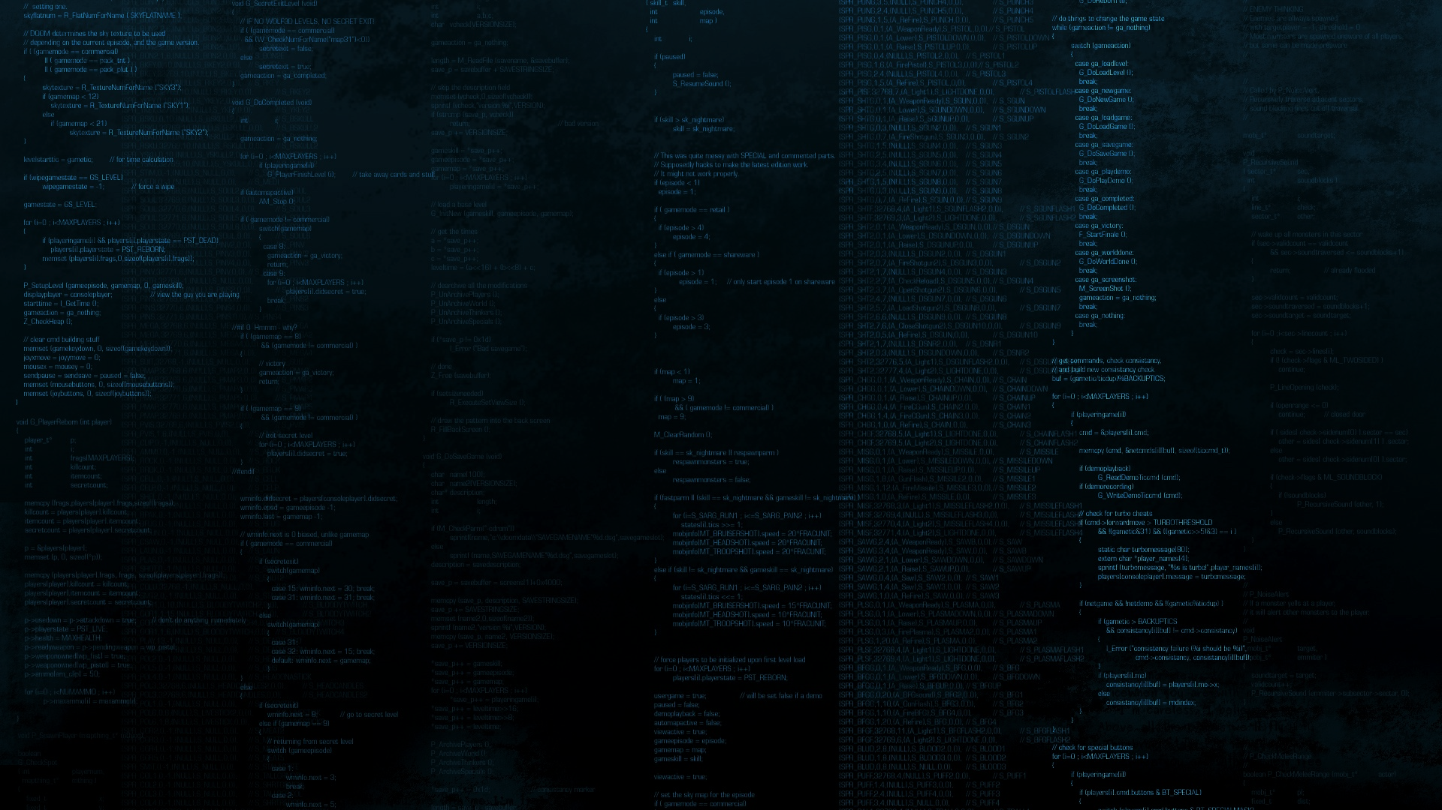








INNOVATIVE PROJECT
ELLEN MEULENIJZER
2022
Notes:
https://unsplash.com/photos/AXu2aZ3YgP8

Slide 2

IDEE

Slide 3
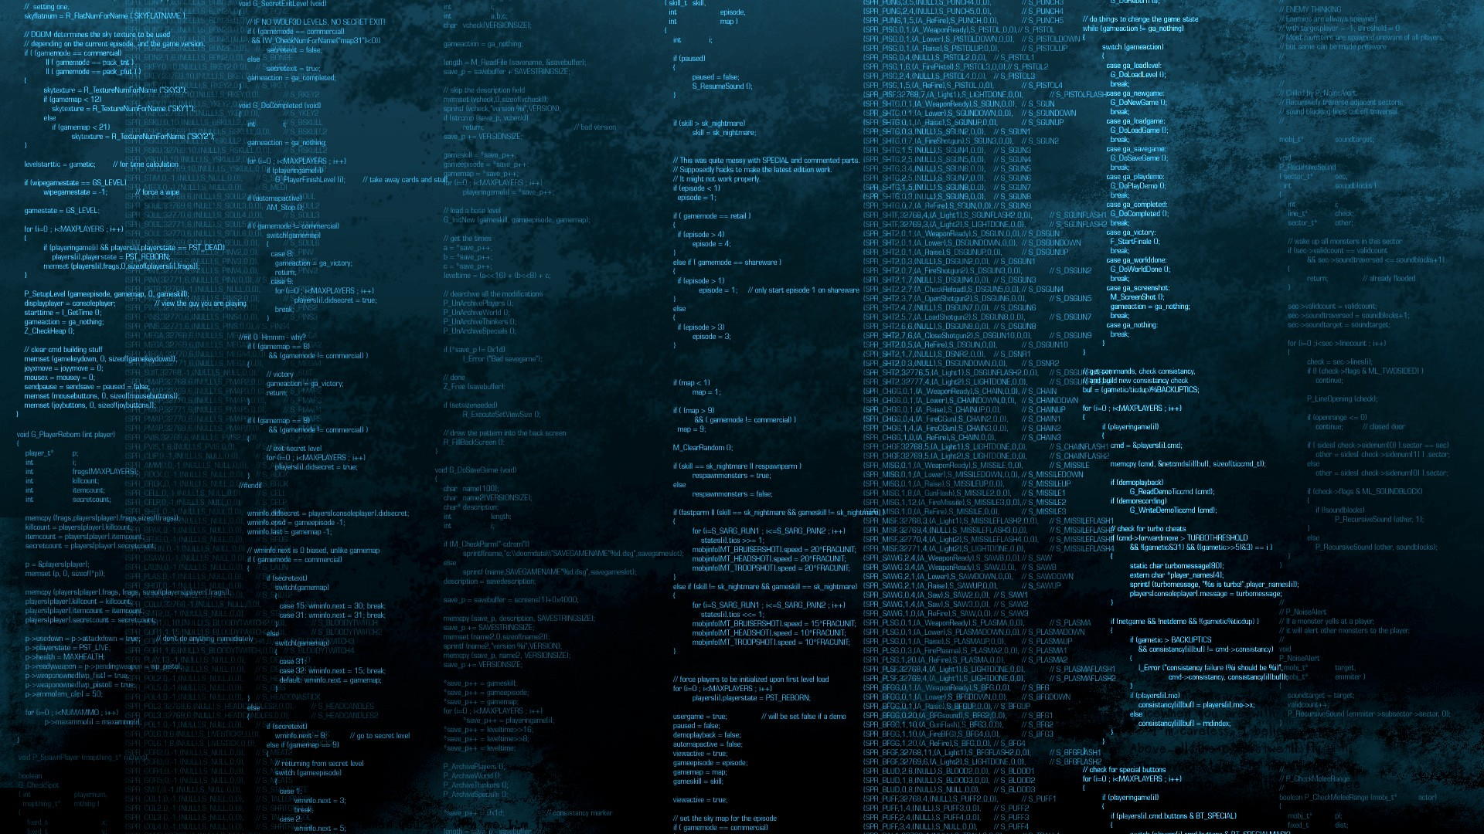
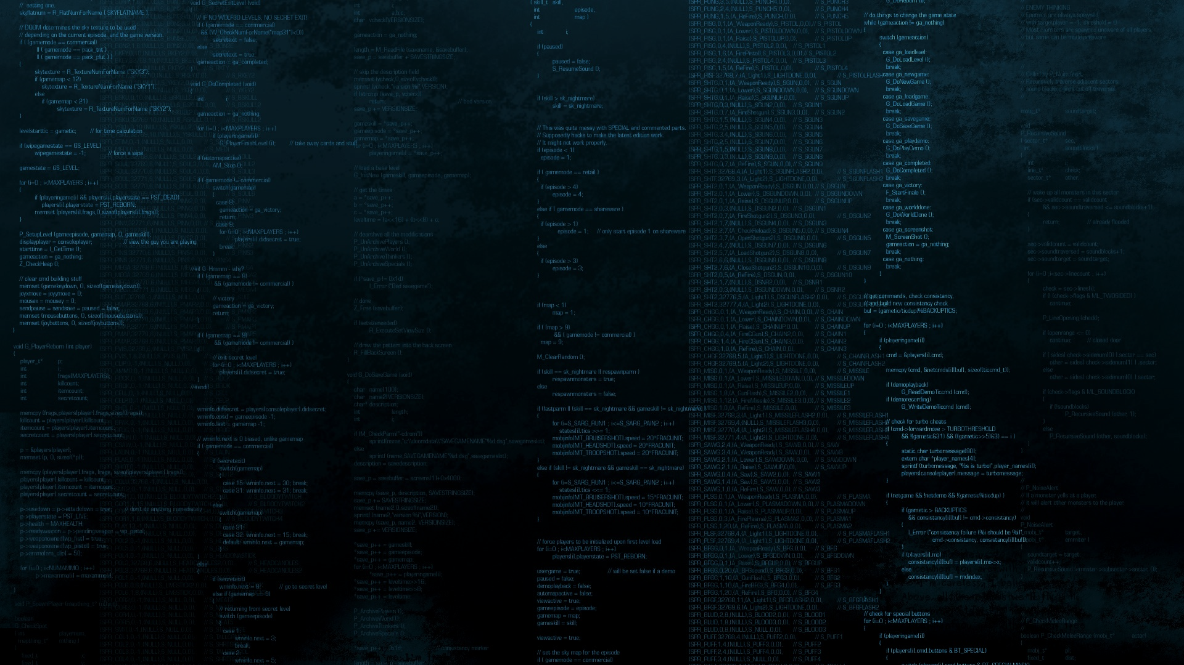
IDEE
3D FPS Zombie game
(First Person Shooter)
Notes:
https://unsplash.com/photos/fItRJ7AHak8

Slide 4
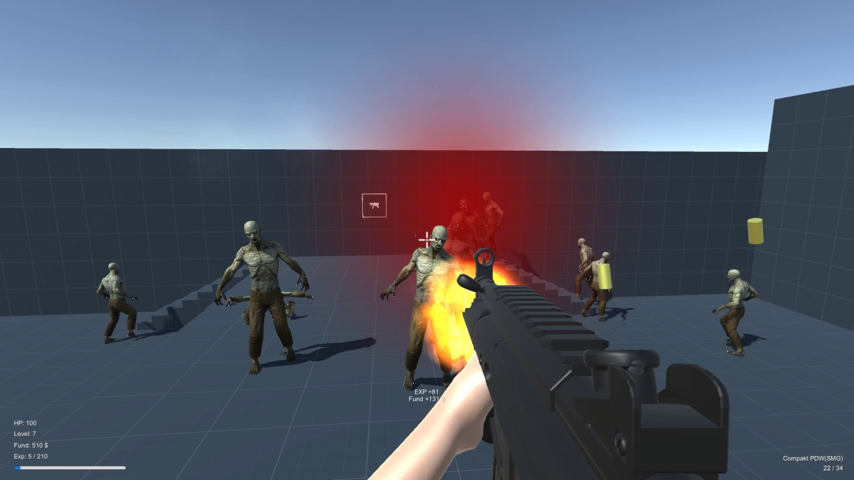

Slide 5
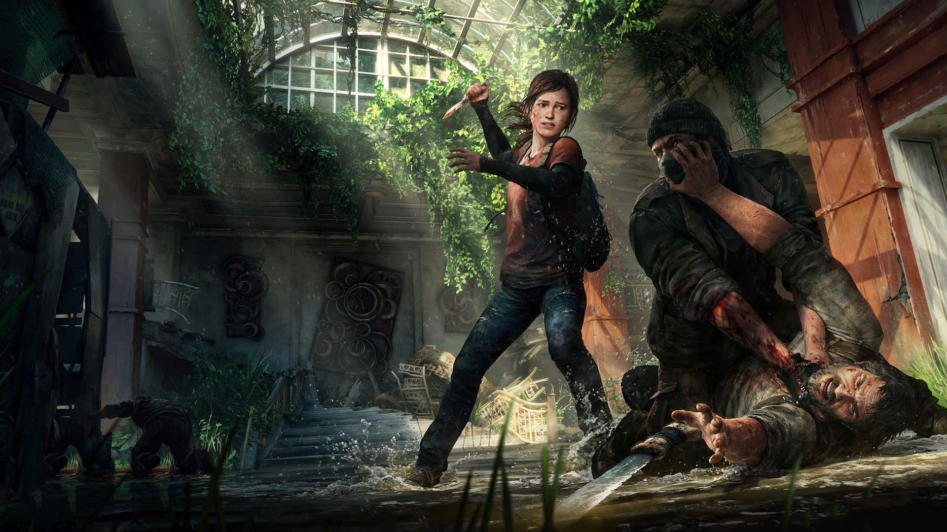
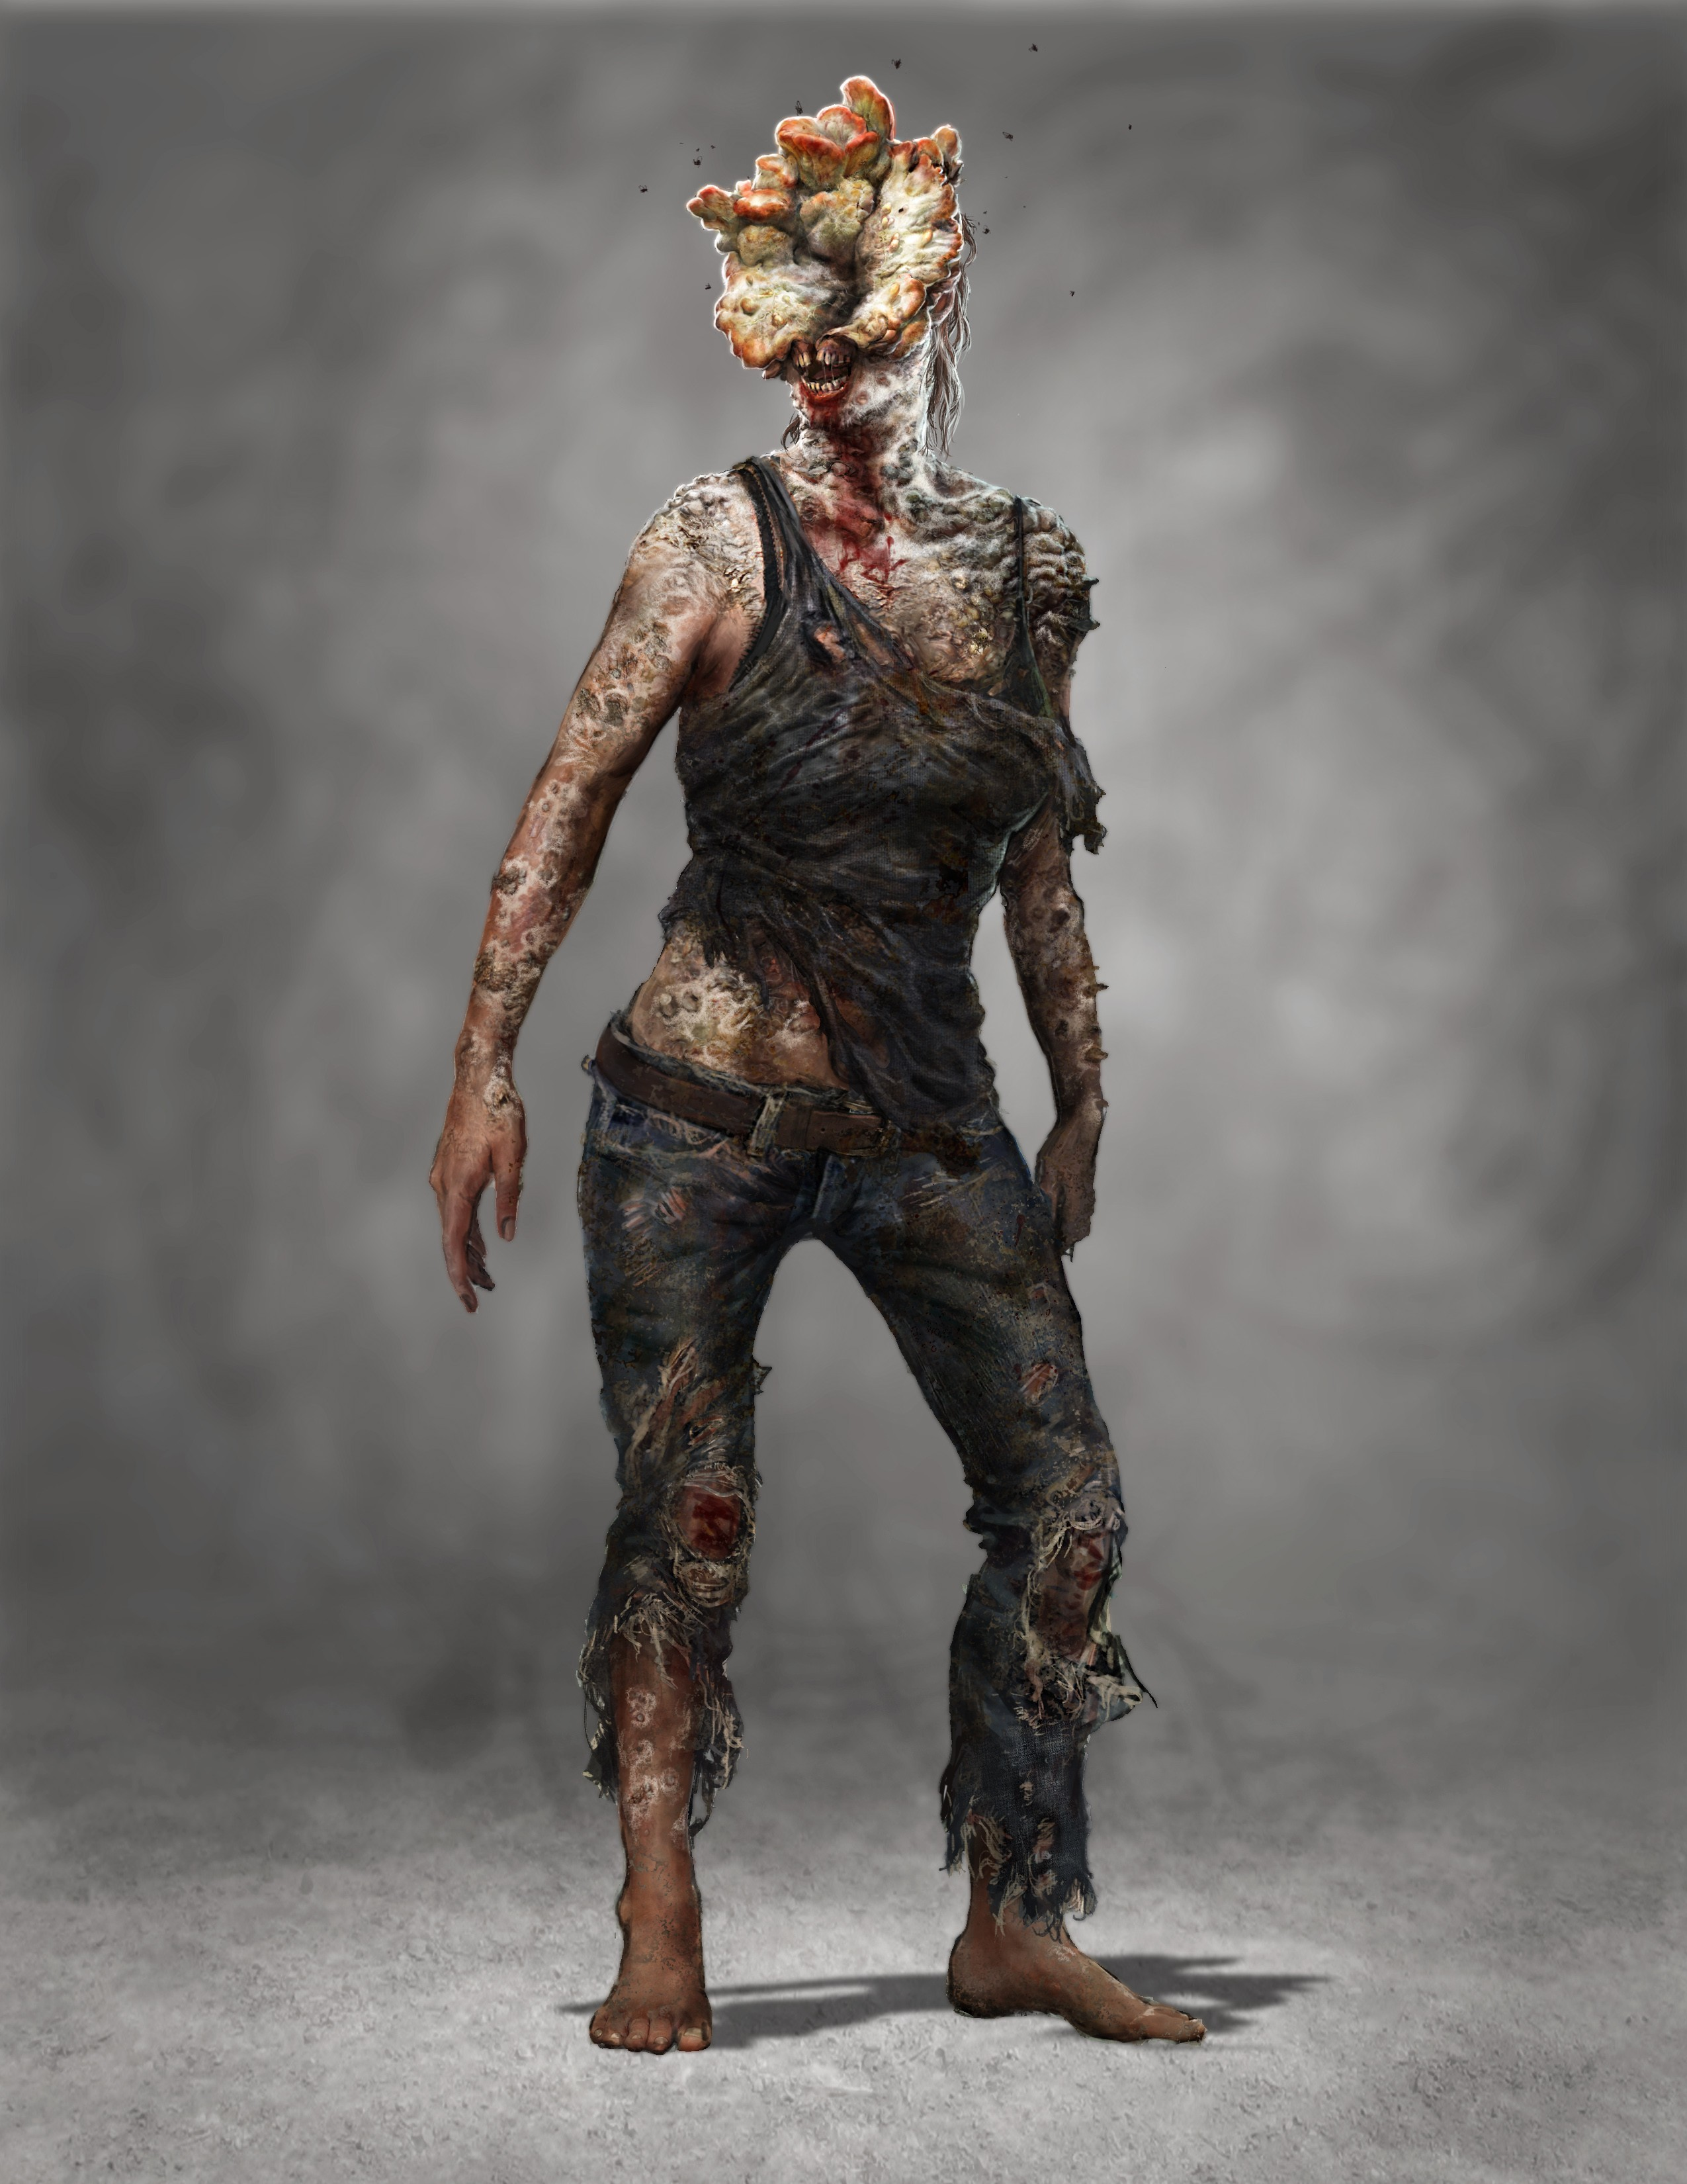

Slide 6

PROTOTYPE

Slide 7
PROTOTYPE
level (school)
Wave System
Extra wapens : Bijl
Zombies (AI)
Ammo
Sleutel vinden
Lootboxes
Ontsnappen
Highscores
Notes:
https://unsplash.com/photos/TvN54bnuQg8

Slide 8
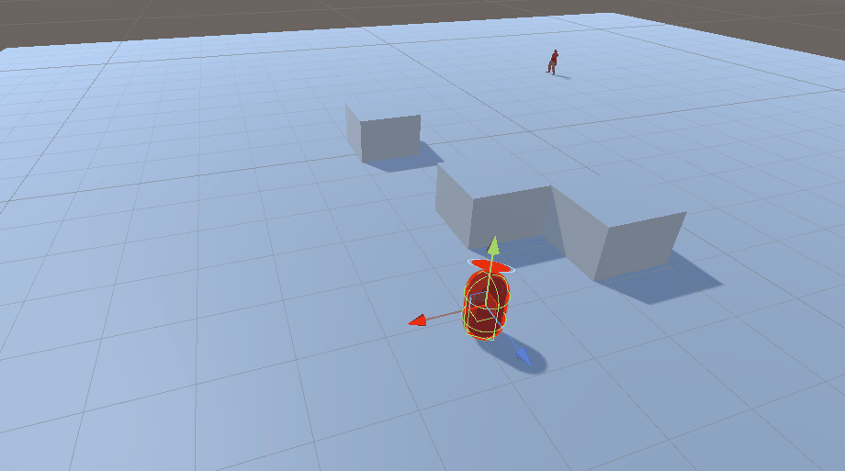

Slide 9

TECHNOLOGIEËN

Slide 10



TECHNOLOGIEËN
C#
Unity (3D)
AI (Zombies)
Notes:
https://unsplash.com/photos/GKLIsLZxhj0

Slide 11

VRAGEN?

Slide 12
VRAGEN?
Notes:
https://unsplash.com/photos/48nerZQCHgo

Slide 13
Bedankt voor jullie aandacht !

